Slide 1
Moving Through New York City in New Year’s Eve
An exploratory data analysis of the city that never sleeps on new year’s eve

Slide 2
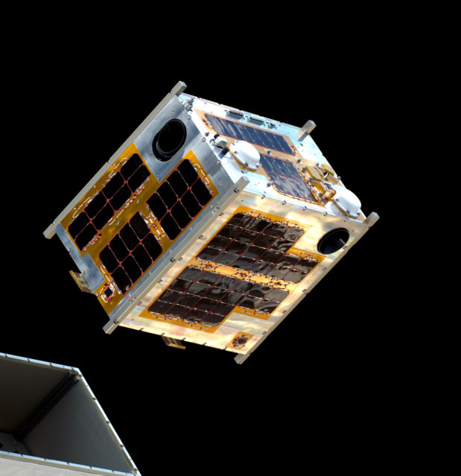

NYC New Year’s Eve
Each year, hundreds of thousands of people gather at New York Times Square during New Year’s Eve.
To anticipate this year’s NYE, this analysis will provide insights on how people in New York City move during new year’s eve by using the data for yellow taxi trips on that day.
https://www.timessquarenyc.org/times-square-new-years-eve/nye-history-times-square-ball

Slide 3
Data
Collecting data

Slide 4
Data
Data was obtained in NYC OpenData https://opendata.cityofnewyork.us/
Only yellow taxi trips from 6:00 of 31 Dec 2018 to 6:00 of 1 Jan 2019 were obtained for this analysis

Slide 5
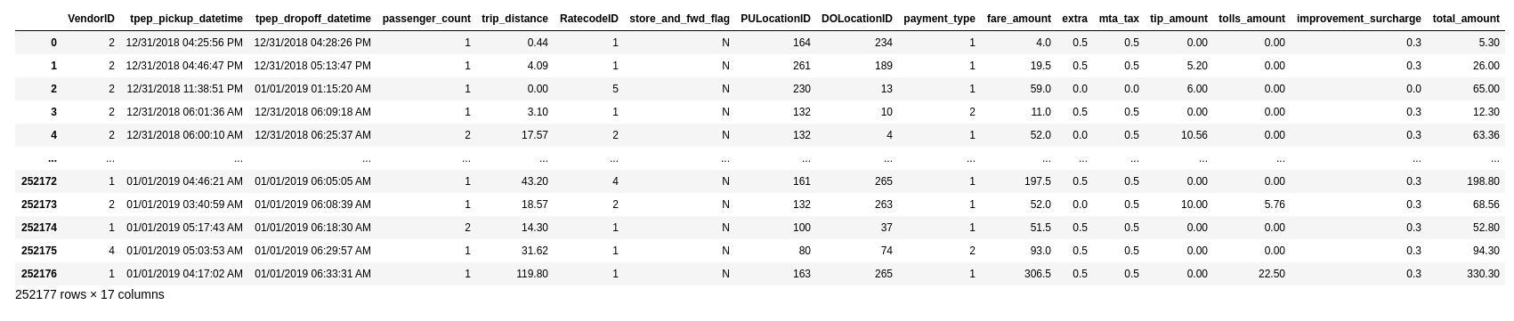
Data

Slide 6
Column | Description
VendorID | A code indicating the TPEP provider that provided the record. 1= Creative Mobile Technologies, LLC; 2= VeriFone Inc
tpep_pickup_datetime | The date and time when the meter was engaged.
tpep_dropoff_datetime | The date and time when the meter was disengaged.
passenger_count | The number of passengers in the vehicle. This is a driver-entered value
trip_distance | The elapsed trip distance in miles reported by the taximeter.
RatecodeID | The final rate code in effect at the end of the trip. 1= Standard rate 2=JFK 3=Newark 4=Nassau or Westchester 5=Negotiated fare 6=Group ride
store_and_fwd_flag | This flag indicates whether the trip record was held in vehicle memory before sending to the vendor, aka “store and forward,” because the vehicle did not have a connection to the server. Y= store and forward trip N= not a store and forward trip
PULocationID | TLC Taxi Zone in which the taximeter was engaged
DOLocationID | TLC Taxi Zone in which the taximeter was disengaged
payment_type | A numeric code signifying how the passenger paid for the trip. 1= Credit card 2= Cash 3= No charge 4= Dispute 5= Unknown 6= Voided trip

Slide 7
Column | Description
fare_amount | The time-and-distance fare calculated by the meter
extra | Miscellaneous extras and surcharges. Currently, this only includes the $0.50 and $1 rush hour and overnight charges.
mta_tax | $0.50 MTA tax that is automatically triggered based on the metered rate in use
tip_amount | Tip amount – This field is automatically populated for credit card tips. Cash tips are not included
tolls_amount | Total amount of all tolls paid in trip.
improvement_surcharge | $0.30 improvement surcharge assessed trips at the flag drop. The improvement surcharge began being levied in 2015.
total_amount | The total amount charged to passengers. Does not include cash tips

Slide 8
Preprocessing
Turning dirty data usable

Slide 9
Preprocessing
The columns to be dropped are 'VendorID', 'RatecodeID', 'store_and_fwd_flag', 'tolls_amount', and 'total_amount'

Slide 10
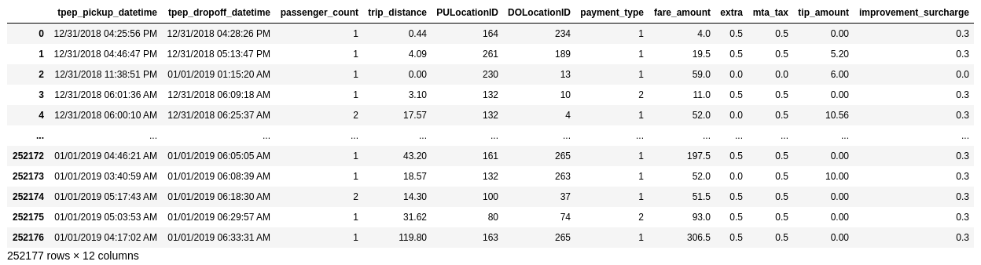
Preprocessing

Slide 11
Preprocessing
Add 'totalCharge' column with values as the sum of 'fare_amount', 'extra', 'mta_tax', and 'improvement_surcharge' columns
Add ‘pickup_time’ and ‘dropoff_time’ with values as the pickup time and dropoff time respectively.

Slide 12
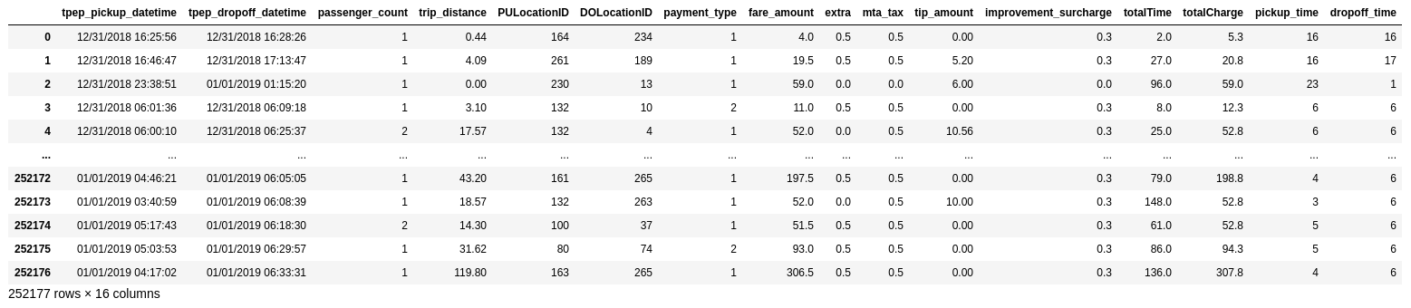
Processed Data
There were 252,175 taxi trips from 6:00 of 31 Dec 2018 to 6:00 of 1 Jan 2019

Slide 13
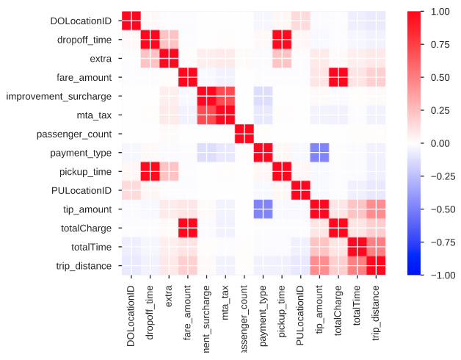
Correlation matrix
Pickup time and dropoff time are highly correlated.
Fare amount and total charge are also highly correlated.
Total charge, tip amount, trip distance, and trip duration (‘totalTime’) all have a high correlation.
Complete profile report is in ‘Profile_Report.html’

Slide 14
Taxi trips in NYC on New Year’s Eve 2018
To see how people in New York moves on new year’s eve, analysis on the processed data will be separated into temporal and spatiotemporal components

Slide 15
Temporal analysis
Telling insights through time

Slide 16
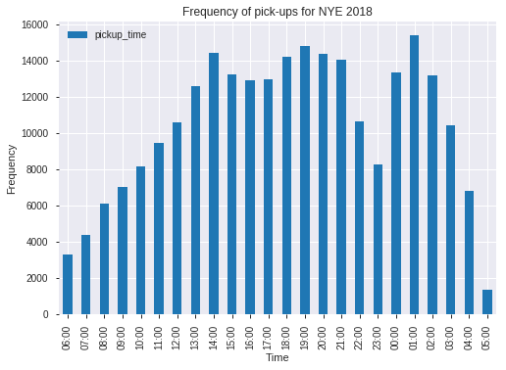
Taxi pickup frequency per hour
Most taxi pickups happened in the afternoon to early evening (14:00 - 21:00) and after midnight (0:00 - 2:00)
There is a dip in pickups at 22:00 - 23:00
The increase and dips in pickups can be attributed to people anticipating the NYE celebration at Times Square.

Slide 17
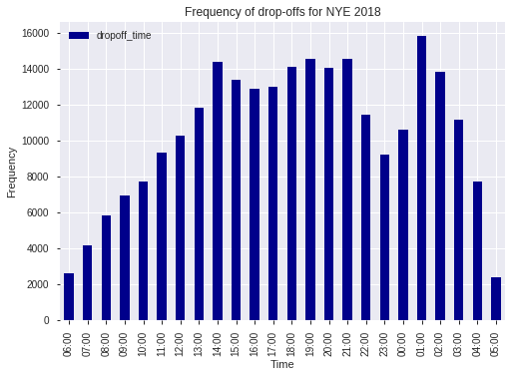
Taxi dropoff frequency per hour
The dropoff frequency per hour is similar to the pickup frequency per hour as expected from the correlation matrix (p = 0.978)
This means most taxi trips happened within the same hour.

Slide 18
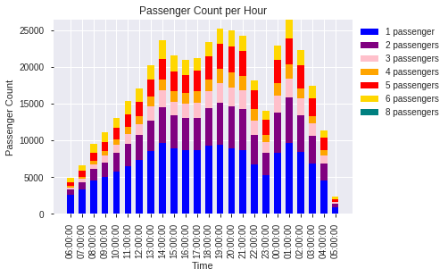
Passenger count per hour
As expected from the pickup/dropoff frequency per hour plot, most people took a taxi ride at 1:00 or after the NYE celebration, suggesting most passengers came from Times Square.
This confirms that more people take a taxi ride in the afternoon (before NYE) and after NYE celebration.

Slide 19
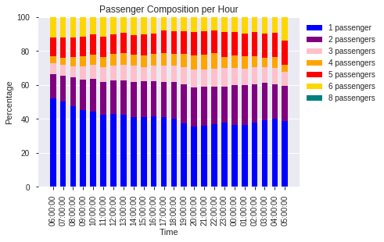
Passenger composition per hour
Single passengers are the largest passenger group that took a taxi ride per hour
Almost half of the taxi trips per hour are single-passenger trips
But more non-single-passenger trips happen around the time period for NYE celebration (20:00 - 1:00)

Slide 20
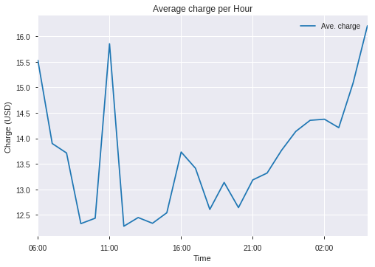
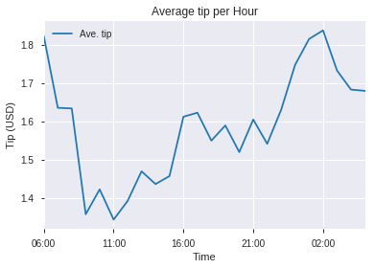
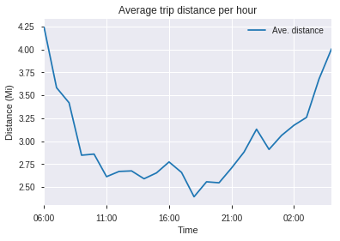
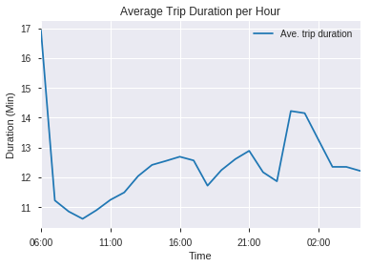
How much, how long, how far?
As shown in the correlation matrix, totalCharge, tip_amount, trip_distance, and totalTime has high correlation with each other.
Similarly, their averages per hour also follow a similar trend. (outlier at 11:00 for ave. charge per hour)

Slide 21
How much, how long, how far?
Taxi drivers can earn more after NYE celebration as shown with ave. charge per hour and ave. tip per hour
It’s better for people to take a taxi ride around 16:00 in new year’s eve for a more cost effective and time efficient trip.

Slide 22
How much, how long, how far?
Average trip duration and trip distance for 6:00 of 31 Dec 2018 hour is higher than any other time.
Although there were less taxi trips for this hour, this article might explain why is such the case. (clue: police lined the Times Square with barricades)

Slide 23
Spatiotemporal analysis
Telling insights through time and space

Slide 24
New York taxi trips heatmap
There’s an increase in taxi pickups at JFK Airport at 6:00, 16:00, and 23:00
And also an increase at LaGuardia Airport at 10:00
Most pickups before and after 0:00 can be found in Manhattan suggesting people celebrating NYE at Times Square.

Slide 25
New York taxi trips heatmap
Interestingly, most taxi dropoffs after 3:00 are found in the residential areas in Brooklyn, Queens, and Bronx.
This suggests that post-NYE celebrations ended around 3:00 where people got home from Manhattan.

Slide 26
NYC on NYE 2018
In conclusion:
New York City was populated with 252,175 yellow taxis for NYE 2018.
Most of which travelled through Manhattan (Times Square), residential areas in NYC (Bronx, Queens, Brooklyn), and at the airports (LaGuardia and JFK).
Of all these taxi trips, most happened in the afternoon and after NYE celebration suggesting most people took a taxi at these times.

Slide 27
NYC on NYE 2018
In conclusion:
Based from these data, commuting to Manhattan via yellow taxis for NYE celebration at around 16:00 is more cost effective and time efficient.
On the other hand, a taxi driver can earn more after NYE celebration.

